Slide 1


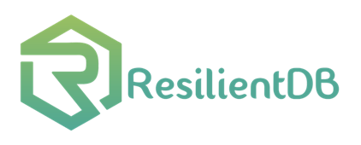

Resilient and Scalable Architecture for Permissioned Blockchain Fabrics
Suyash Gupta
RISE / SkyLab
University of California, Berkeley
https://gupta-suyash.github.io/

Slide 2
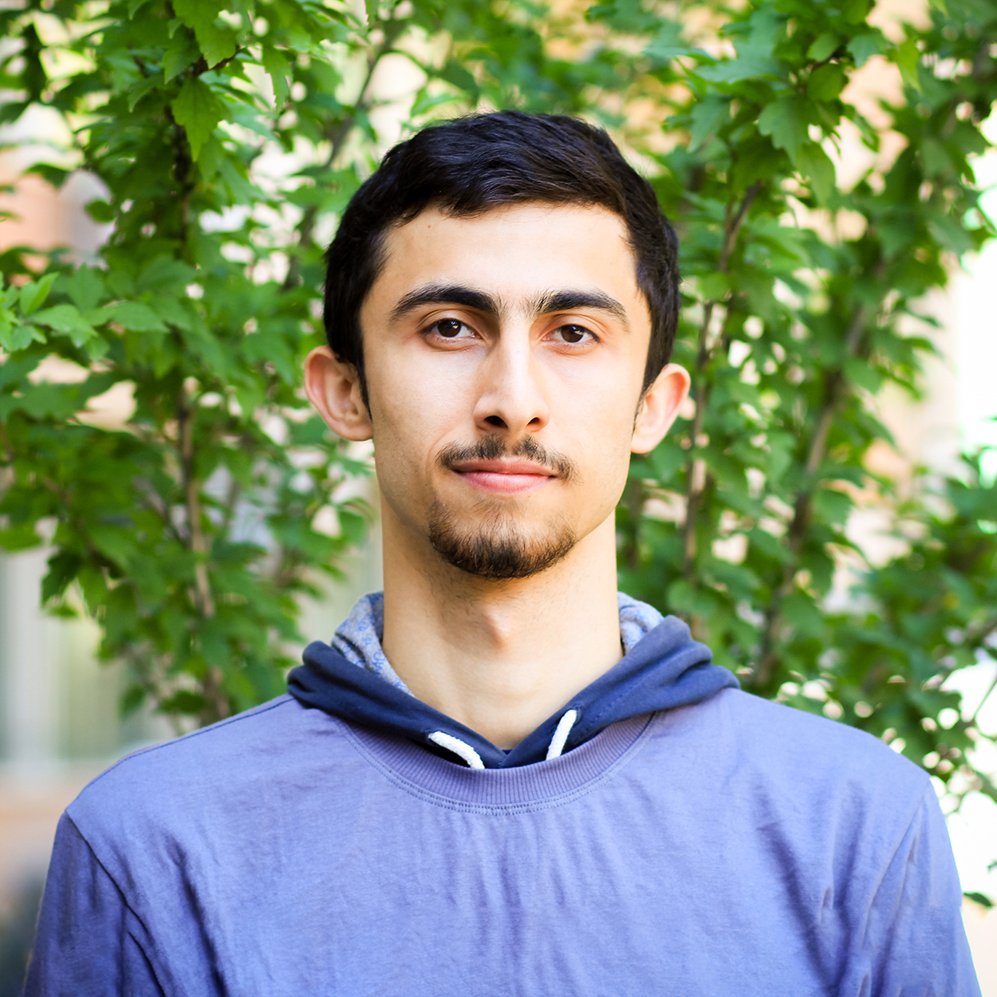

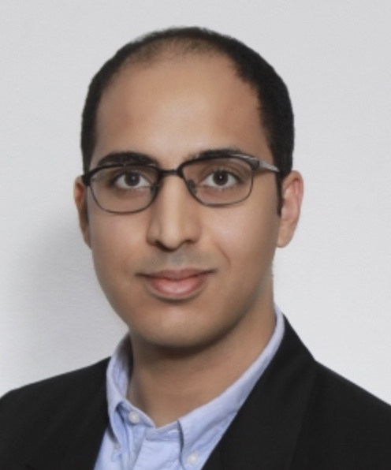
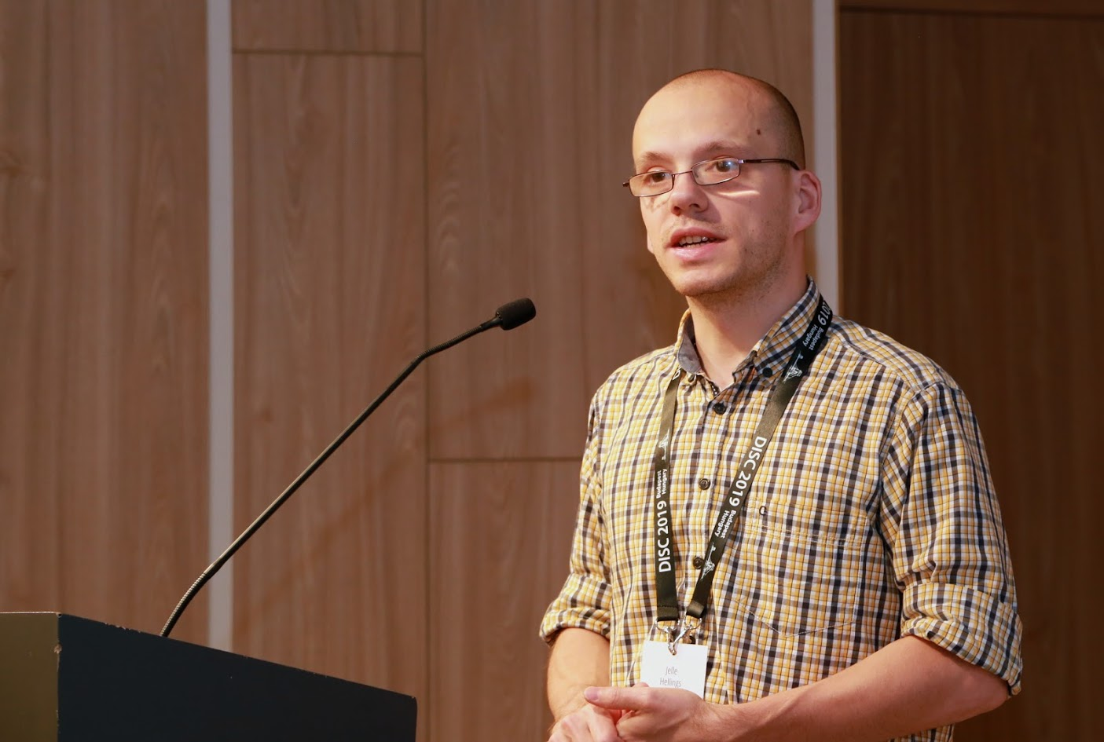
Awesome Collaborators
Sajjad Rahnama
Mohammad Sadoghi
Natacha Crooks
University of California, Berkeley
University of California, Davis
Faisal Nawab
University of California, Irvine
Jelle Hellings
McMaster University

Slide 3

Statutory Warning!
In this talk
We will not learn how to trade cryptocurrencies.
We will not mine Bitcoins.
I do not know NFTs!

Slide 4

One Line Problem Statement
Distributed systems managed by untrusted parties need fast and reliable protocols to manage their data.

Slide 5



Bank
Savings
Savings
Bob
Alice

Slide 6
Bank
Wants to Buy House
Wants to Buy House
Bob
Alice

Slide 7
Bank
Alice gets House Loan
Bob is denied Loan!
Bob
Alice

Slide 8
How could this happen?
Bank’s Control: Centralization

Slide 9


Gives Bad Loans
Bank
Volde
Bankrupts
Bob
Alice

Slide 10
Bank
Volde
Blocks Savings
Blocks Savings
Bob
Alice

Slide 11
How could this happen?
Bank’s Control: Centralization
Bank’s Choice: Monopoly
Lack of Democracy
No Voice

Slide 12
Possible Solution???

Slide 13
Blockchain Technology
Decentralization
Democracy
Control of Data
Right to Vote

Slide 14






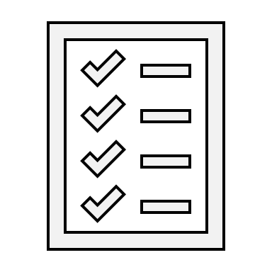





Blockchain Applications
Project Tracking
Energy Trading
and Management
Cryptocurrencies
Healthcare
Waste
Management

Slide 15
What is Blockchain?
New
Block
Previous
Hash
Genesis
Previous
Hash
Previous
Hash
Data
Data
Data
Client Transactions
Linked List of Blocks
Hash of Previous Block

Slide 16



Blockchain Network
Alice
Bob

Slide 17





Blockchain: Decentralization → Replicas
Alice
Bob

Slide 18




Blockchain: Democracy → Vote
Alice
Bob

Slide 19

Voting Rules → Consensus
Every replica should vote once!
Count each vote only once!
Winner → who gets majority of votes.
Ensure only one winner!

Slide 20


Everything is fine until there are Adversaries!
Alice
Volde

Slide 21


Solution → Byzantine-Fault Tolerant Consensus
Secure
Authenticated

Slide 22

Minimal Expectations!
Be Safe → All replicas should have same state.
X = 1
X = 1
X = 1

Slide 23


Minimal Expectations!
Stay Live → System should continue processing transactions from good clients.

Slide 24


First practical BFT implementation.
Practical Byzantine Fault Tolerance (PBFT)
Alice
T
Primary
Replica 1
Replica 2
Byzantine
Client
Request
Pre-Prepare
O(n)
Prepare
O(n²)
Commit
O(n²)
Reply
Execute
Two Phases of O(n²)!!!
Consensus among n replicas & at most f byzantine → n >= 3f+1
n = 4 replicas and f <= 1

Slide 25
Several Exciting Solutions
Twin-path protocols →
Zyzzva [SOSP’07], SBFT [DSN’19]
Fast-path (no failures), and If failures → Slow-path like PBFT.
Severe throughput degradation during path switching.
Streamlined protocols →
HotStuff [PODC’19]
Linear consensus with no support for concurrent consensus invocations.

Slide 26









RingBFT [EDBT’22]
GeoBFT [VLDB’20]
Reliable Edge [arxiv’22]
RCC [ICDE’21]
FlexiTrust
[arxiv’22]
PoE [EDBT’21]
ResilientDB
[ICDCS’20]
PBFT

Slide 27

Speculative Execution
Proof-of-Execution (PoE)*
Three-phase Linear protocol
Out-of-Order Consensuses
No dependence on clients or trusted component.
*In proceedings of EDBT 2021.

Slide 28

Proof-of-Execution (PoE)
Alice
T
Primary
Replica 1
Replica 2
Byzantine
Client
Request
Pre-Prepare
Prepare
Certify
Reply
Execute
n = 4 replicas and f <= 1

Slide 29
Magical Ingredient → Client Commit implies Finality
If client receives n-f responses → Transaction will persist in time.
Replicas may be required to rollback.

Slide 30
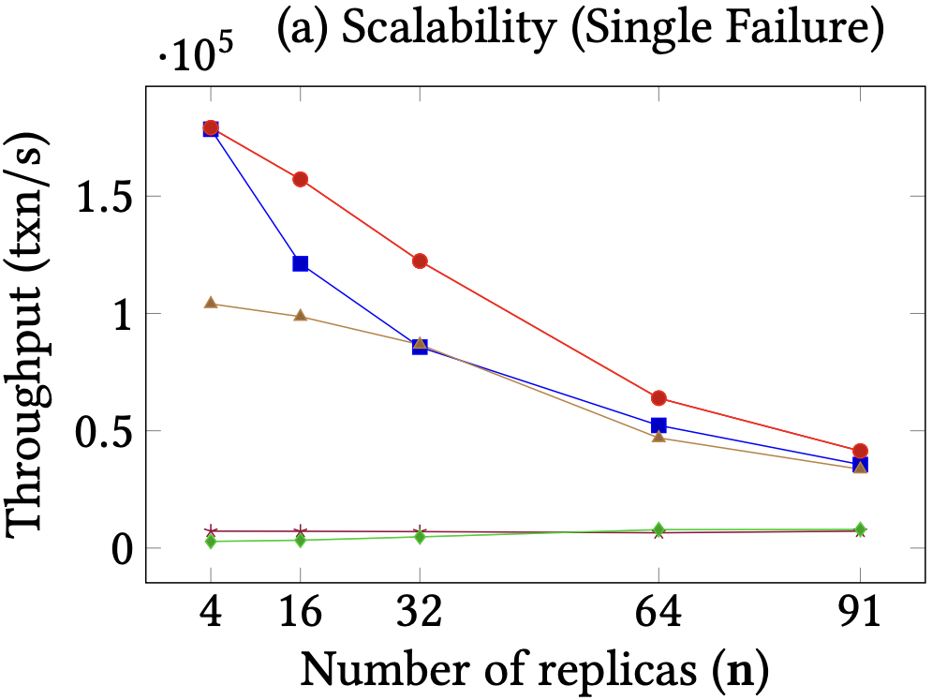
PoE Scalability

Slide 31




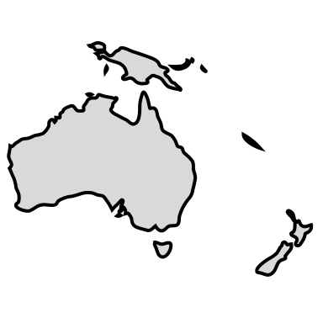
What if replicas are globally scattered?

Slide 32
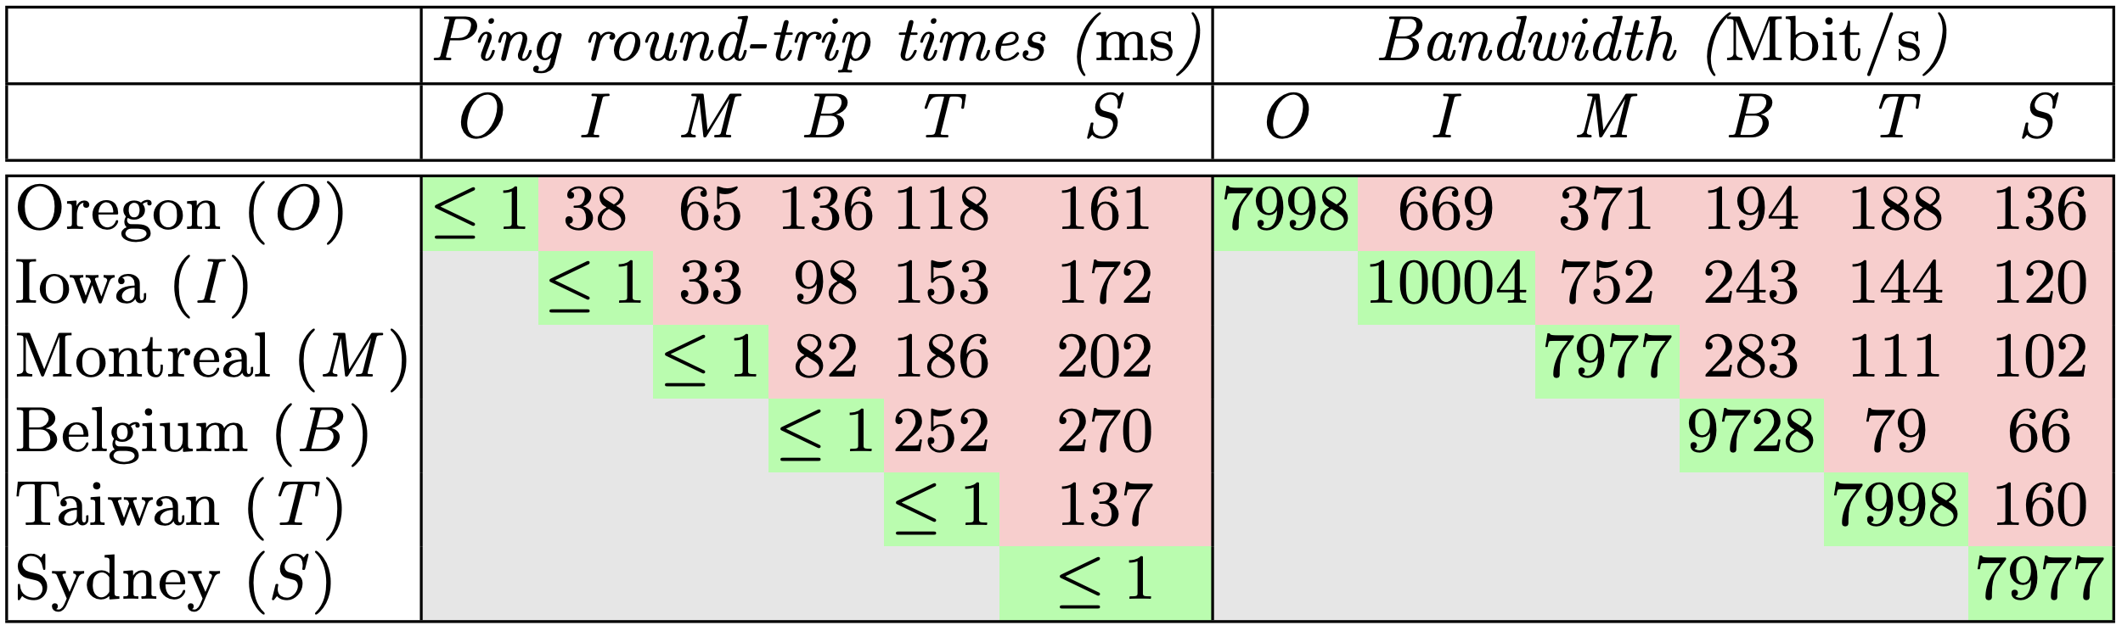

Challenges For Geo-Scale Blockchains
High!
Low!
Blockchain expects decentralization → Replicas maybe geo-distributed

Slide 33

GeoBFT Protocol*
Local Replication
Inter-cluster Sharing
Ordering and Execution
Each cluster runs BFT to select, locally replicate, and certify a client request.
Primary at each cluster shares the certified client request with other clusters.
Order the certified requests, execute them, and inform local clients.
Topology-aware meta-protocol.
Parallel consensus at each cluster.
Low inter-cluster communication overheads.
*In proceedings of VLDB 2020.

Slide 34
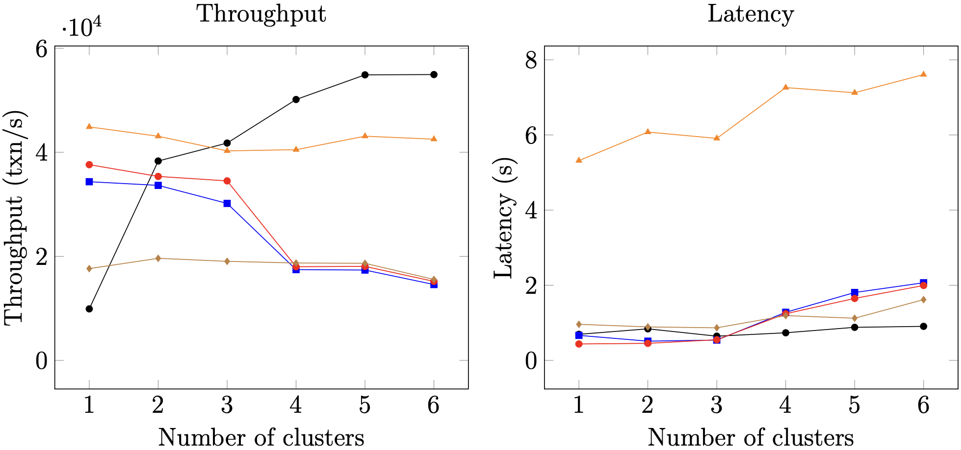
GeoBFT Scalability

Slide 35




What Limits Current Systems? Primary-Backup Paradigm
OK
OK
Replace Primary
System Halts
Order Txn
Primary
OK
Fall in throughput!
Primary

Slide 36
Our Proposal
Democracy → Give all the replicas the power to be the primary.
Parallelism → Run multiple parallel instances of a BFT protocol.
Decentralization → Always there will be a set of ordered client requests.
Resilient Concurrent Consensus

Slide 37

RCC Paradigm*
Parallelism
Ordering
Execution
BFT protocol
Run z parallel BFT
instances.
Create a global order
of all the requests.
Execute the requests
in a global order.
Number of
Instances (z)
*In proceedings of ICDE 2021 and DISC 2019.

Slide 38
Alice
T
1
Primary
Replica
2
1
Replica
2
Bob
T
Primary
Replica
1
2
Byzantine
Replica
1
2
Request
Pre-Prepare
Prepare
Commit
Reply
RCC using PBFT with 2 parallel instances.

Slide 39

Challenges?
How to securely order the requests?
Does failure of one instance causes other instances to stop?
Can there be continuous ordering of requests?
How to fend against coordinated attacks?

Slide 40



Ordering Attack
transfer(A,B,m) → if
bal(A) > m
then
bal(A) = bal(A) – m;
bal(B) = bal(B) + m;
Benefit to Bob!
T1: transfer(Alice, Bob, 2)
T2: transfer(Bob, Eve, 1)
Alice
Bob
Eve
3
1
5
0
5
2
0
3
0
2
0
1
Case 1: T1 then T2
Case 2: T2 then T1

Slide 41
Magical Ingredient → Secure Ordering
In round r, each replica does the following:
Collects requests from the z instances.
Hash each requests.
Creates a sequence S of these hashes.
Calls the function fS on S.

Slide 42
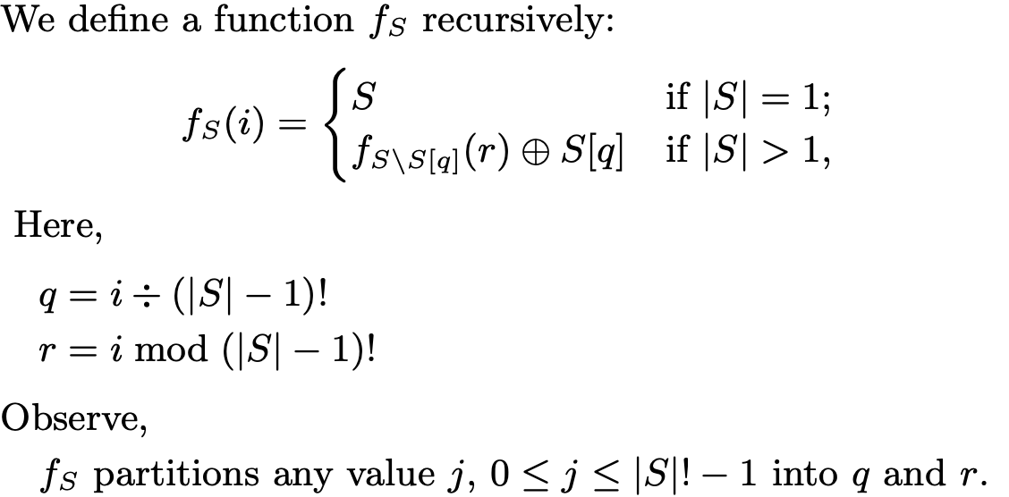
Magical Ingredient → Secure Ordering

Slide 43


Malicious Primaries Collusion
Good Replicas
|A| = f
Good Replica
|C| = 1
Good Replicas
|B| = f
T₁
T₁
T₂
T₂
T₁
T₂
P₁
|M| = f
Liveness in Danger!
P₂
Other f-2
Malicious Replicas

Slide 44
Magical Ingredient → Good Instances are always Live
Failed instances are stopped and not replaced through independent consensus.
Failed instances can be restarted in future.
Failed instances are stopped and not replaced through independent consensus.
Failed instances can be restarted in future.
Collusion attacks detected when f+1 blame multiple primaries.
Lightweight checkpoints ensure progress.

Slide 45


ResilientDB: High Throughput Yielding, Scalable Permissioned Blockchain Fabric*
Visit at: https://resilientdb.com/
*In proceedings of ICDCS 2020 and VLDB 2020.

Slide 46
Why Should You Chose ResilientDB?
Bitcoin and Ethereum offer low throughputs of 10 txns/s.
Existing Permissioned Blockchain Databases still have low throughputs (20K txns/s).
Prior works blame BFT consensus as expensive.
System Design is mostly overlooked.
ResilientDB adopts well-researched database and system practices.

Slide 47
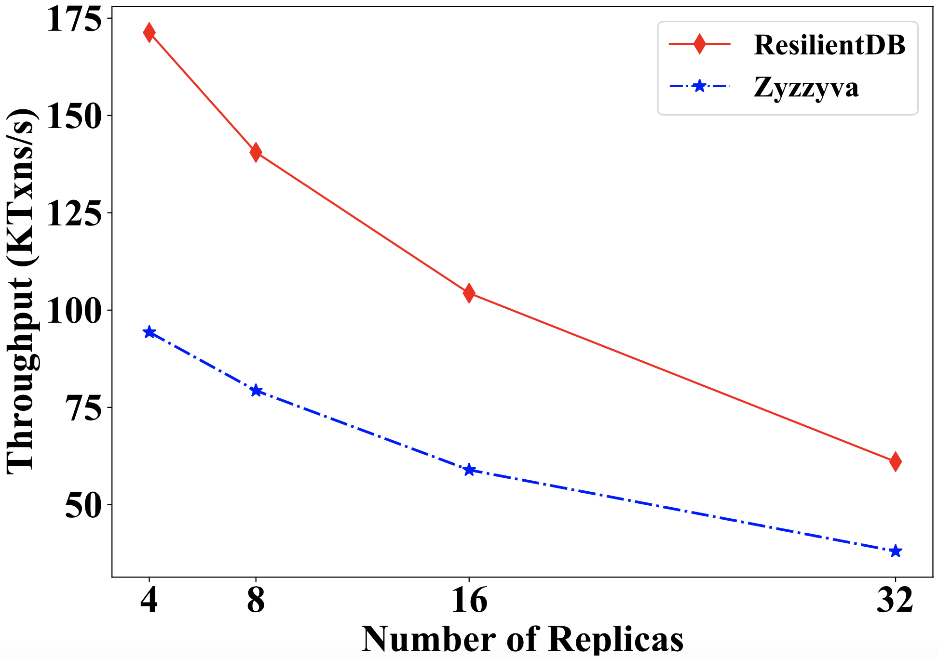
Can a well-crafted system based on a classical BFT protocol outperform a modern protocol?

Slide 48
ResilientDB Architecture
SECURE
LAYER
EXECUTION LAYER
THREADS
SIGNING
TOOLKIT
QUEUES
NET WORK
HASHING
TOOLKIT
BFT CONSENSUS
STORAGE LAYER
METADATA
BLOCKCHAIN

Slide 49
Implementation on ResilientDB
Network
Network
REPLICA
Client
Requests
Batching
Prepare & Commit
messages
Input
Output
Message from
Clients and Replicas
Message to
Replicas or Clients
Worker
Execute
Certificates
from other clusters
Certify
ResilientDB associates a multi-threaded deep-pipelined architecture with each replica.

Slide 50
Evaluating RCC on ResilientDB

Slide 51
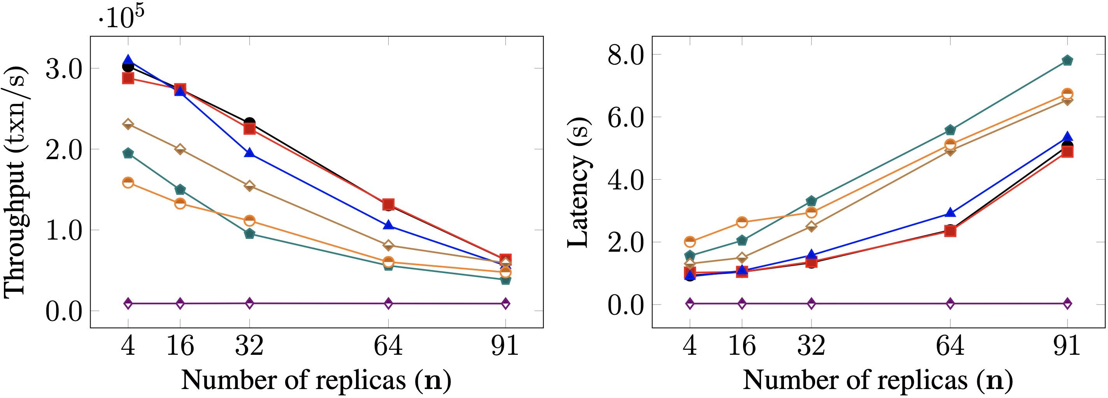
Scalability

Slide 52
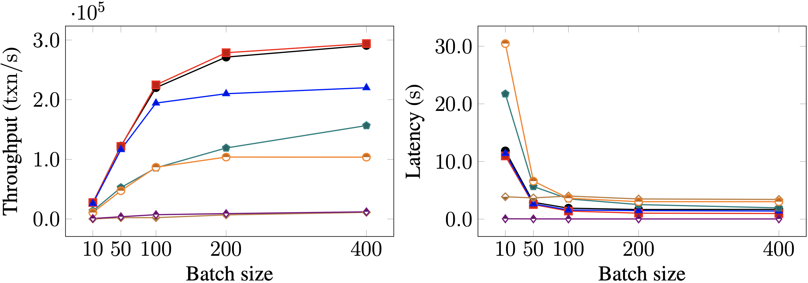
Batching

Slide 53



The Big Picture…
Blockchain as a Service

Slide 54

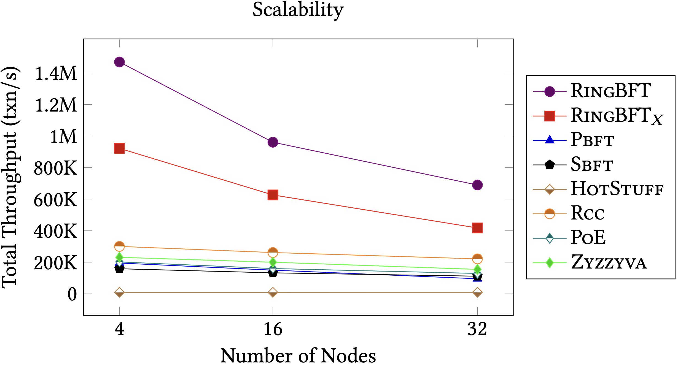
RingBFT: Resilient Consensus over Sharded Ring Topology*
Partitioning (sharding) data across shards helps to scale out.
Existing sharding protocols ignore complex cross-shard txns.
RingBFT scales up to 500 nodes across 15 regions in 5 continents.
RingBFT reaches throughput of 1 million txns/s.
*In proceedings of EDBT 2022.

Slide 55
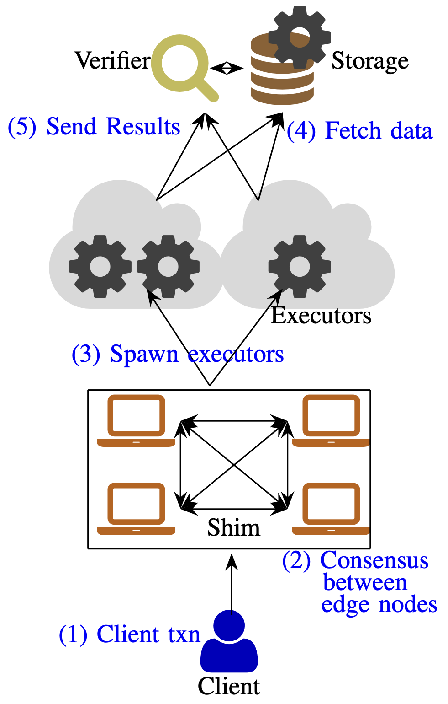

Reliable Transactions in Serverless-Edge Architecture
Edge systems such as IoT serve untrusting parties.
Edge devices require cloud support for computation.
Edge applications require ordering!
How to make this system malicious-resistant!

Slide 56

Dissecting BFT Consensus: In Trusted Components we Trust!
Existing BFT protocols using Trusted Components
Prevent Equivocation
Require 2f+1 replicas
Our Observations
Limited Liveness, Safety, and Lack Concurrency.
Our Proposals
New suite of protocols: FlexiTrust → Safe, Live and Concurrent Protocols.

Slide 57
One Line Conclusion:
Byzantine Fault-Tolerance is still an open problem and existing research overlooks effects of byzantine attacks. Several low hanging fruits to catch!
Check out:
S. Gupta, J. Hellings and M. Sadoghi, Fault-tolerant Distributed Transactions on Blockchain, Morgan & Claypool Synthesis Lectures on Data Management and Springer, 2021.
Reach me:
Twitter: suyash_sg
Email: suyash.gupta@berkeley.edu

